Slide 1
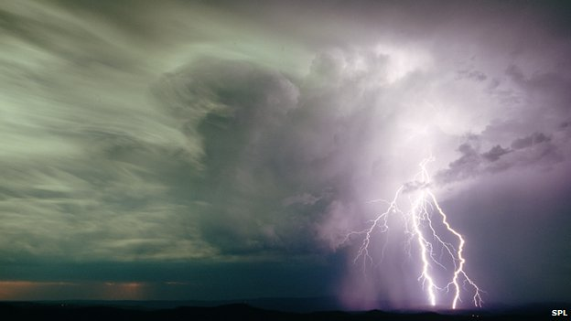


Lecture 8:
NNs for Weather Forecasting
Chris Budd
Notes:
1

Slide 2
Some papers
How PINNs cheat: Predicting chaotic motion of a
double pendulum
Aardvark
GraphCast
Panda: A pretrained forecast model for universal
representation of chaotic dynamics

Slide 3


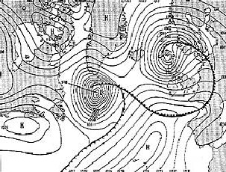
Vital to get a weather forecast right : D Day June 5th/6th 1944
James Stagg, with a bit of Northern Irish help, got the forecast right.
The Germans got it wrong!

Slide 4
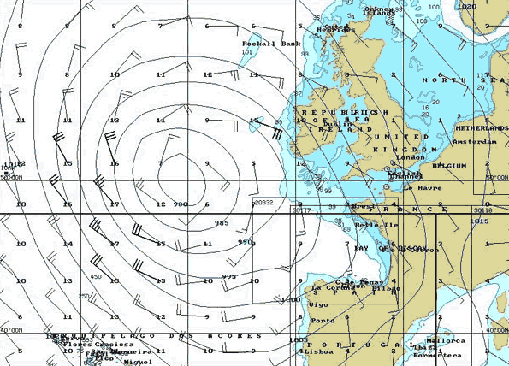
Navier-Stokes equations
Weather forecasting under a week ahead

Slide 5
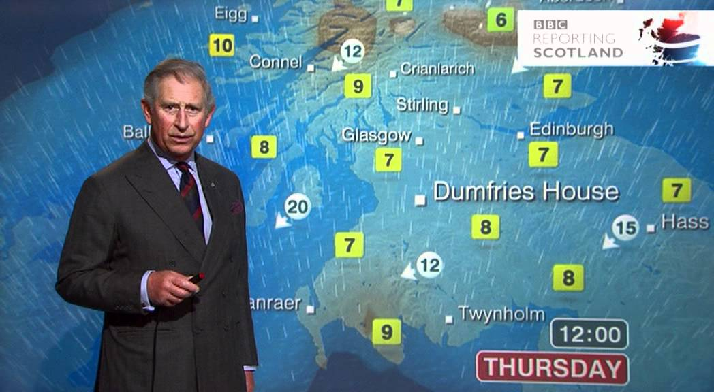
Weather forecasting process
Historical data
Mathematical and numerical model: Dynamical core
Data assimilation
Forecast
Data
Parametrisations

Slide 6
Areas where ML is used in weather forecasting
Post-processing results eg. down scaling
2. Parametrisations eg. clouds
3. Dynamical core/physics: GraphCast
4. End-to-end/data only: Aardvaark

Slide 7
Dynamical prediction of the weather
Physics/PINNs or similar

Slide 8
Complex interrelated processes described by differential equations
Basic equations: Navier-Stokes which describe the weather
Motion
Density
Temperature
Moisture
Pressure
For climate add in ice, CO2, ocean currents, vegetation, …

Slide 9
Certain modelling simplifications make the models easier to analyse:
Geostrophic balance
Hydrostatic balance
Stratification

Slide 10
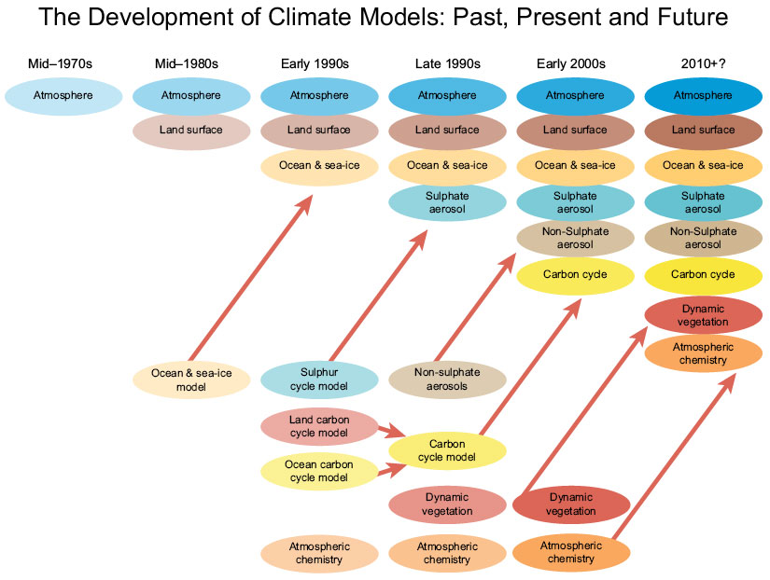
[Hadley Centre]

Slide 11
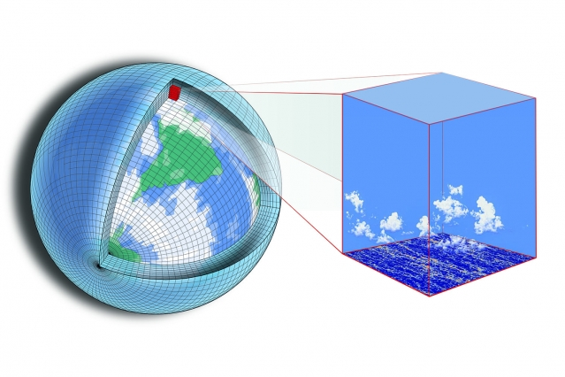
Equations are solved numerically

Slide 12
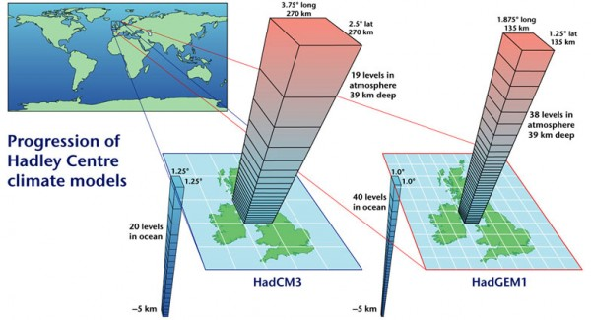
^{100km}

Slide 13
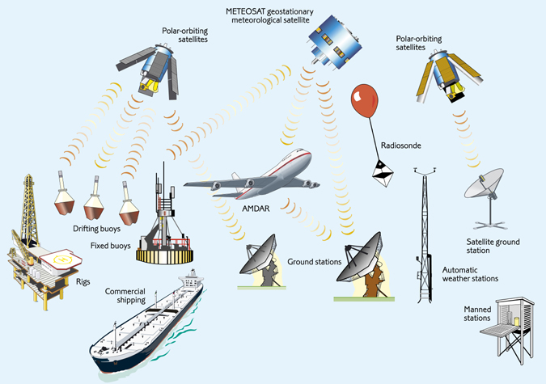
Data: Sources of observation

Slide 14

High performance numerical methods:
Finite volume, semi-Lagrangian, parallel
Ten year testing programme!
High performance numerical methods:
Finite volume, semi-Lagrangian, parallel, deep learning
Ten year testing programme!

Slide 15
The importance of chaos
Chaotic motion is complex, irregular and otherwise unpredictable behaviour which arises from a ‘simple’ system which can be exactly described by ‘simple’ mathematical laws.
Manifested as sensitivity to initial conditions after the Lyapunov time
and complex trajectories on strange attractors

Slide 16
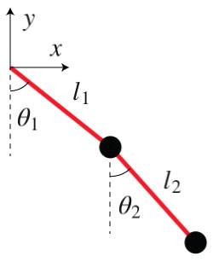
Newton’s laws apply to the double pendulum!
Angle of top part
Angle of bottom part

Slide 17
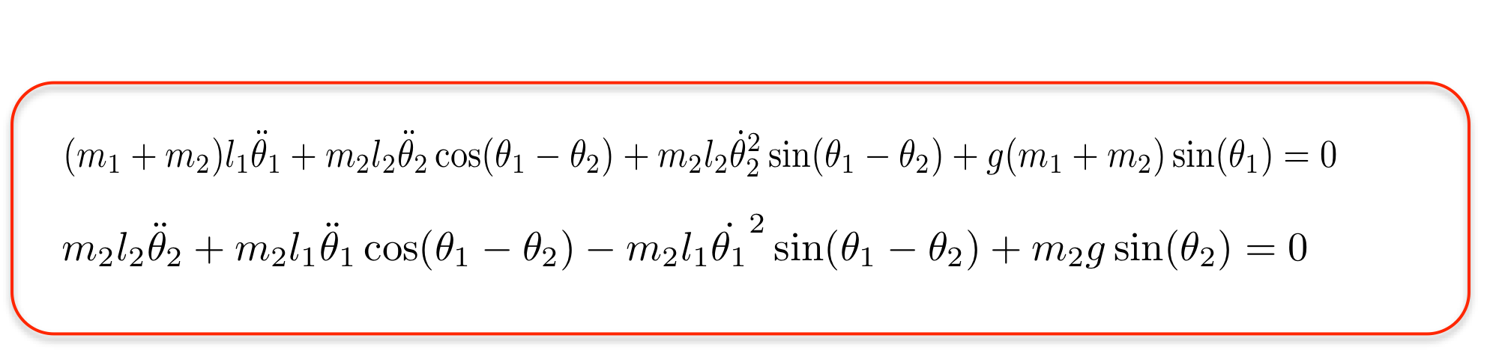
Motion is described by a coupled pair of second order nonlinear ordinary differential equations
Small swings: Can be solved exactly to give in phase and out of phase solutions
Large swings: Solvable numerically. Solutions are chaotic

Slide 18


Slide 19
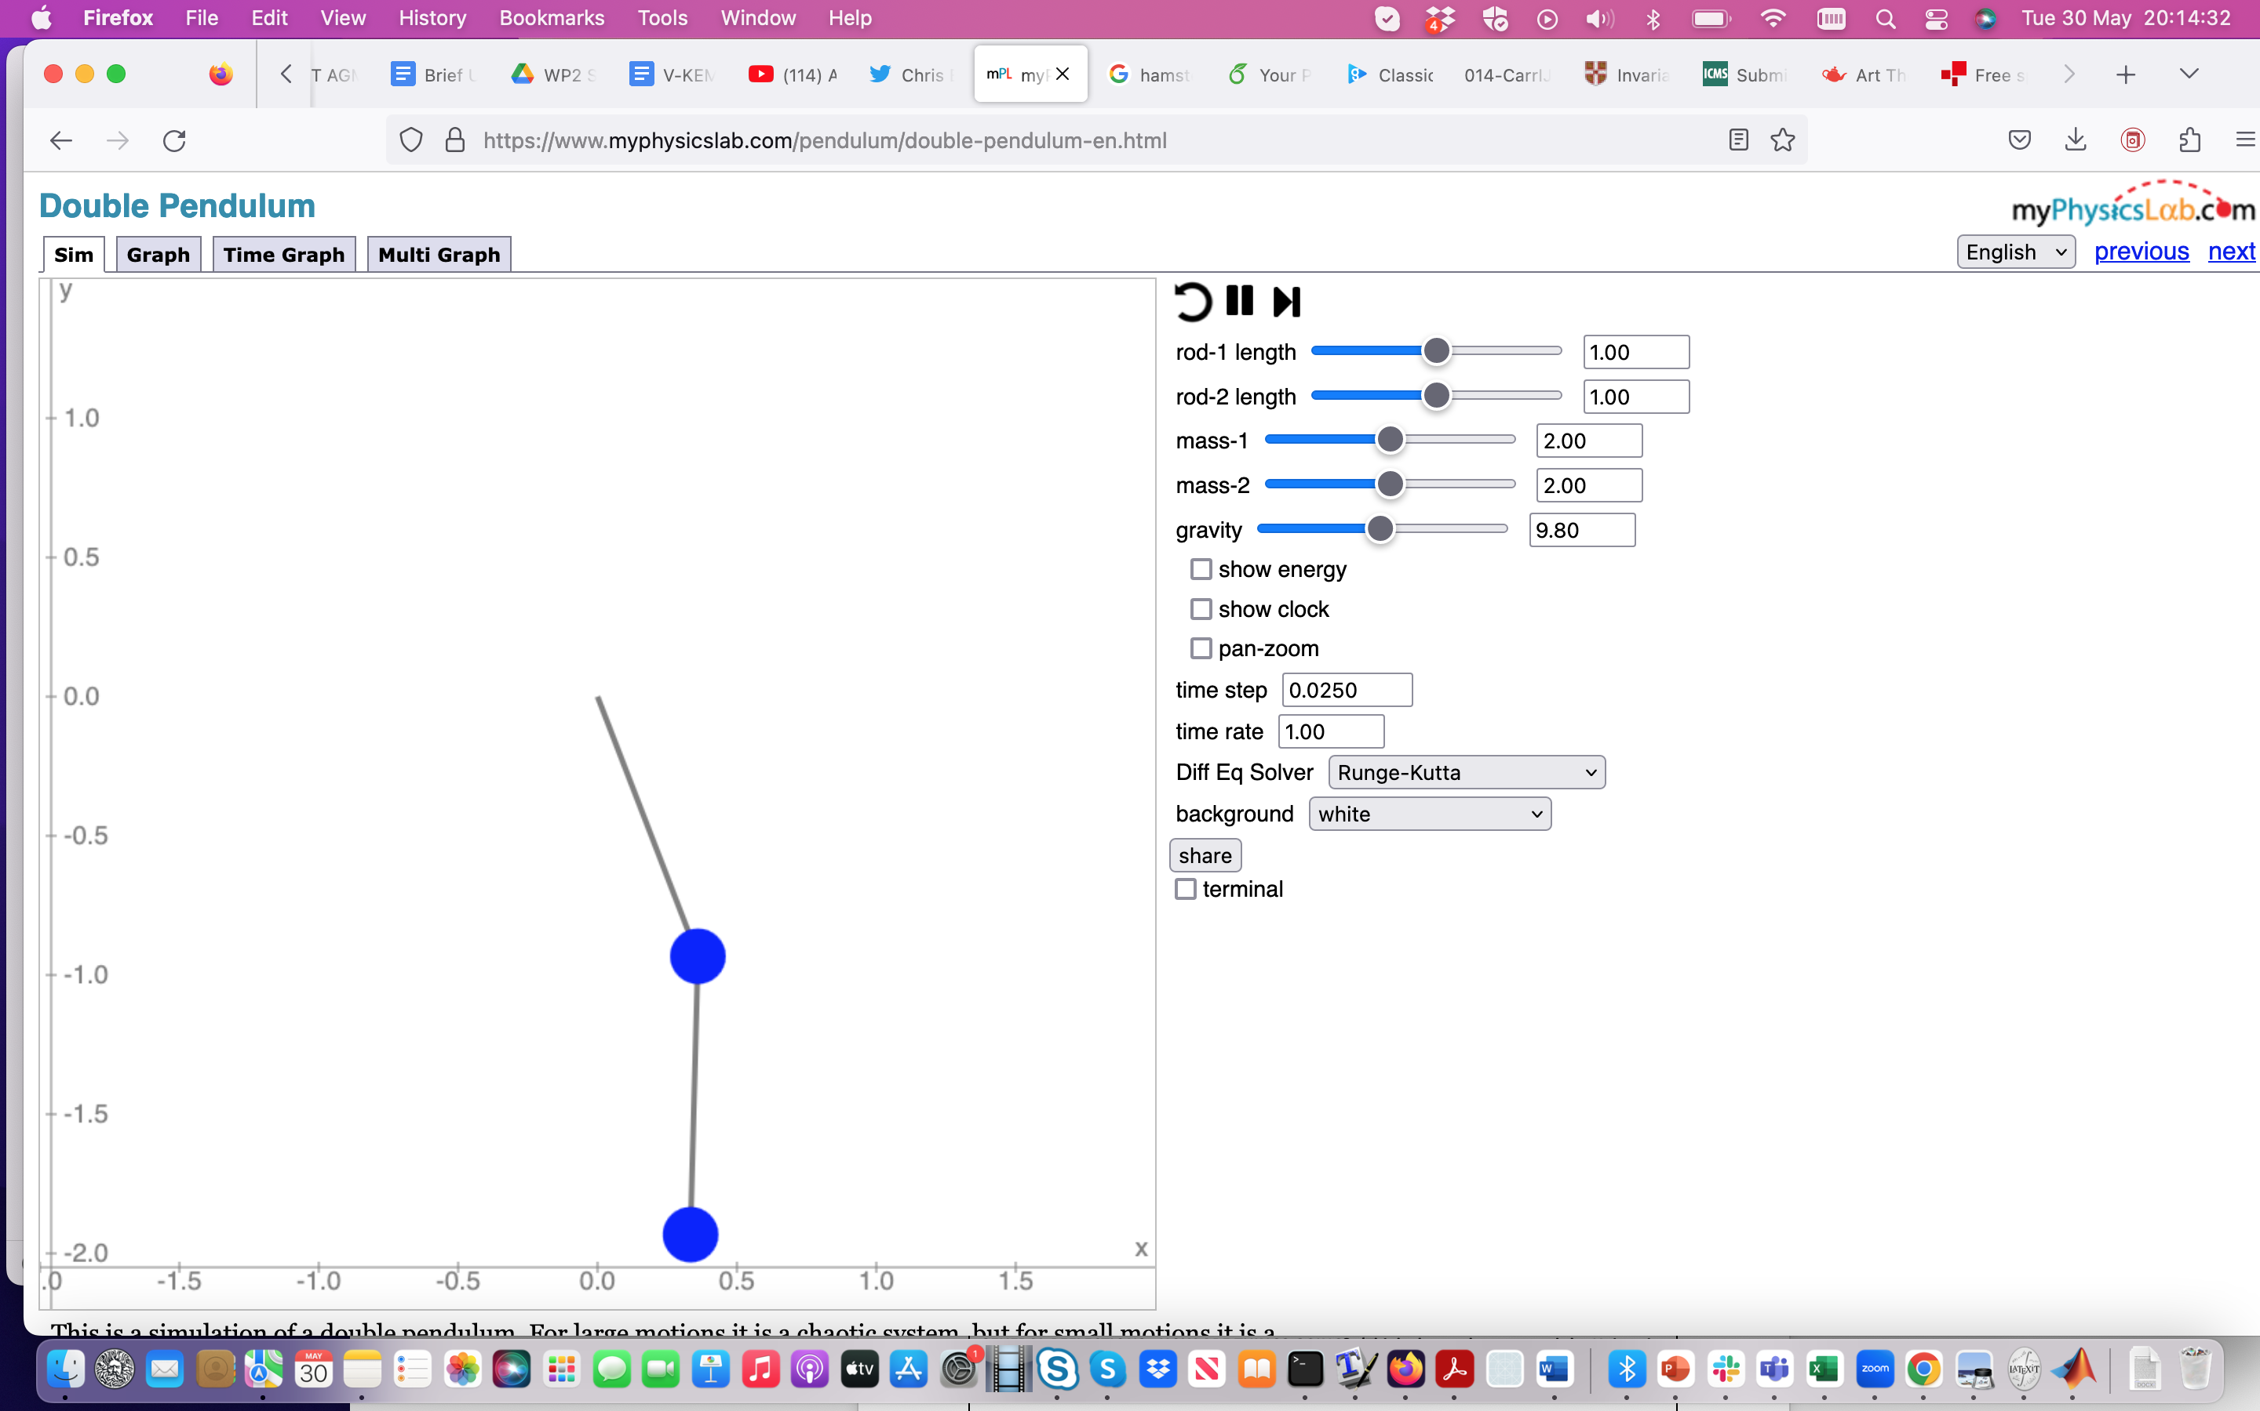

Slide 20

Ed Lorenz

Slide 21
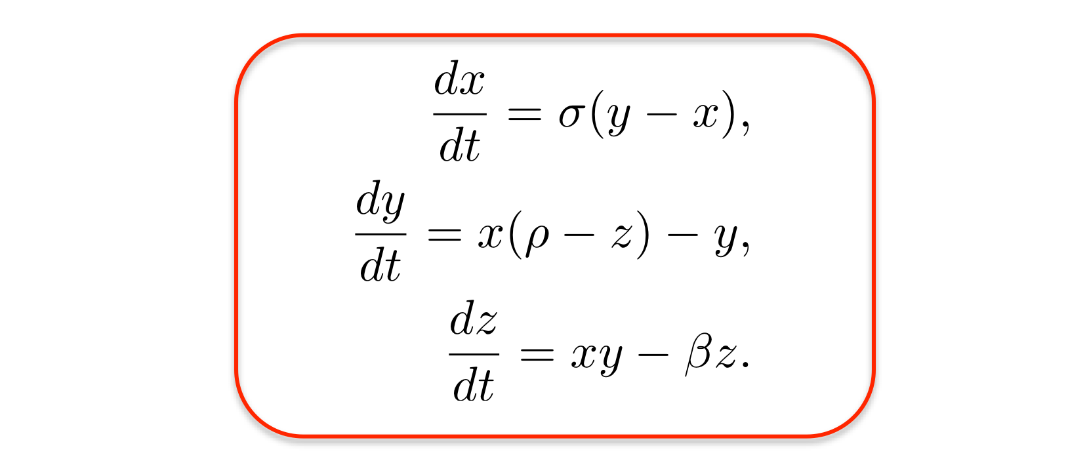
Meteorologist Lorenz (1960s) was studying convection in the atmosphere and derived the Lorenz equations:
Computer studies showed the existence of chaotic solutions.
This came as a complete surprise!

Slide 22
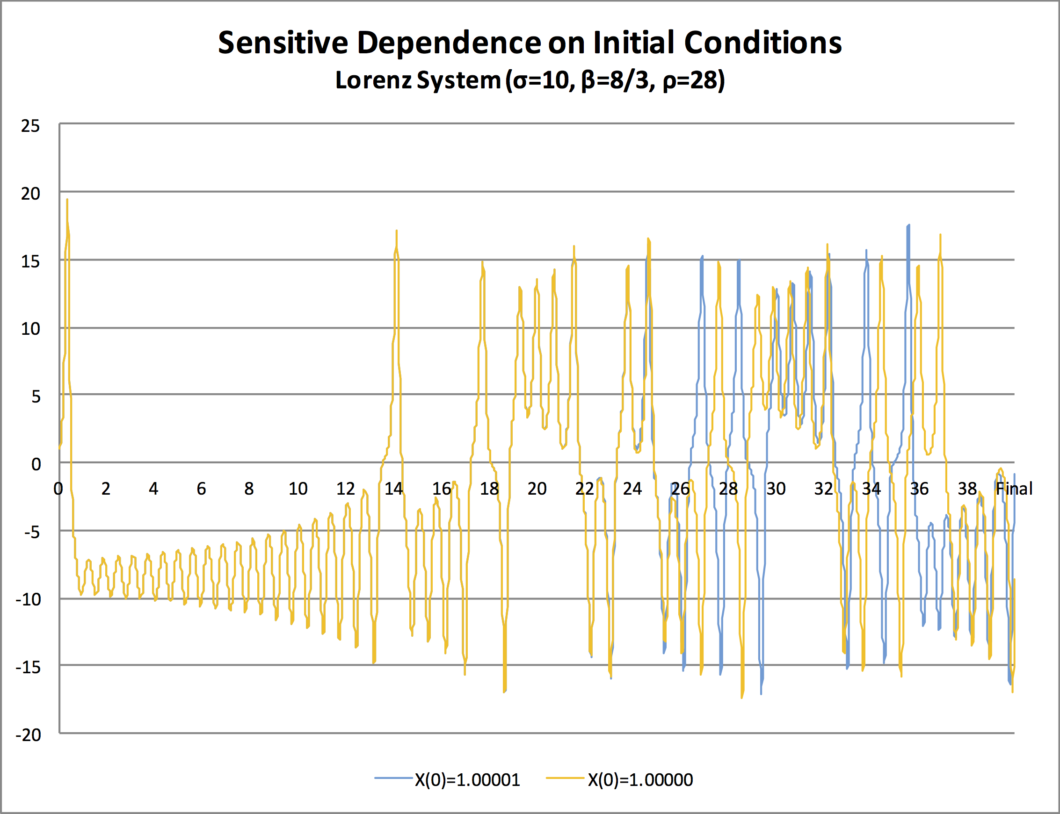
Sensitivity seen after about t = 25

Slide 23
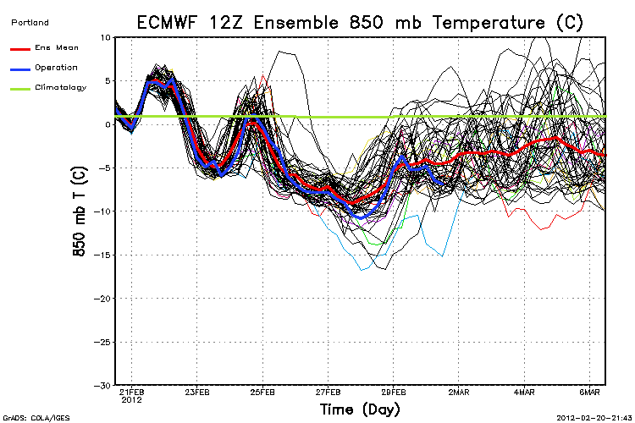
Sensitive dependence of the weather afyer about 10 days

Slide 24
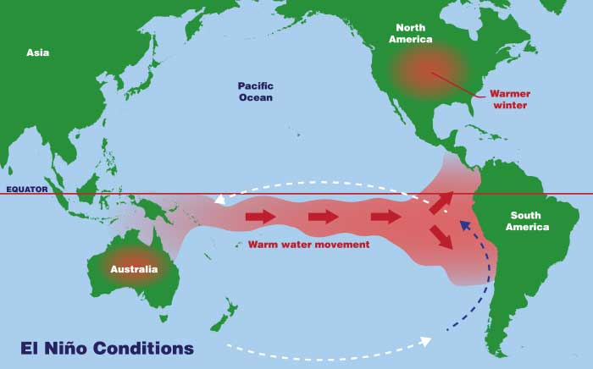
Chaos in real climate: El Nino

Slide 25
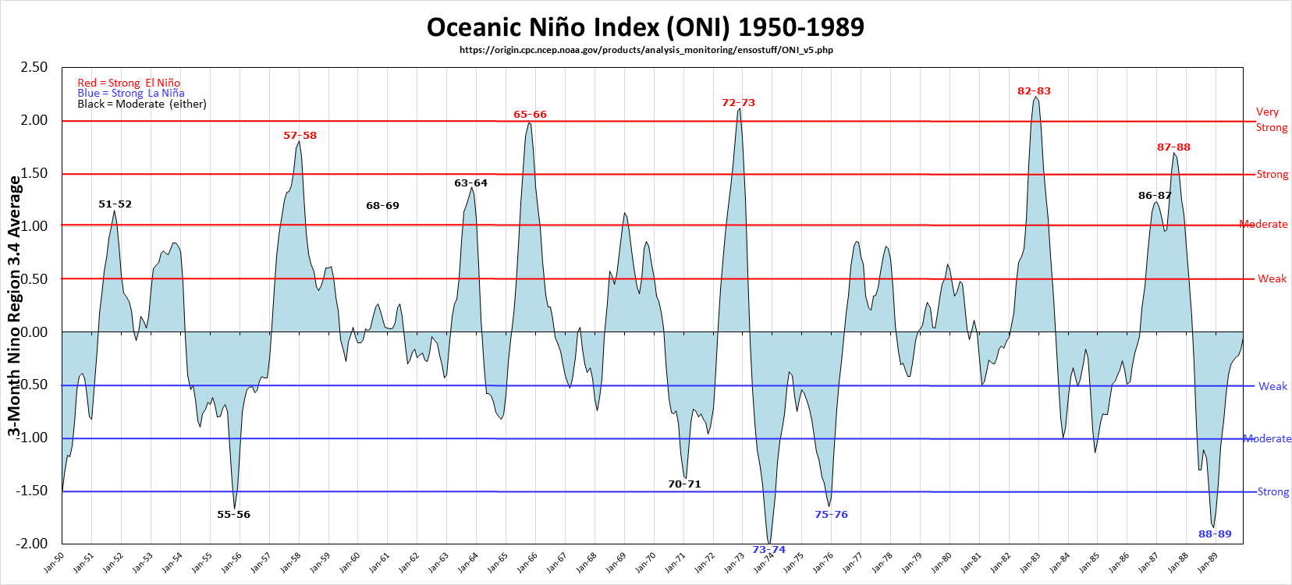

Slide 26
Help is at hand:
Ergodic properties
Dense chaotic attractors
The shadowing lemma
Data assimilation

Slide 27
Picture of the shadowing lemma
That’s the result of the shadowing lemma. It states in formal terms that the perturbed solution we get due to small errors is not the real solution, but it is the solution of some other initial condition (/parameters) that are epsilon close. So when you solve the equation, you don’t get a solution for the parameters [10.0, 28.0, 8 / 3] with initial condition [1.0; 0.0; 0.0], but there is some initial condition and parameters, say [10.0, 28.00000000000000001, 8 / 3] and [1.0; 0.00000000000000000000001; 0.0]

Slide 28
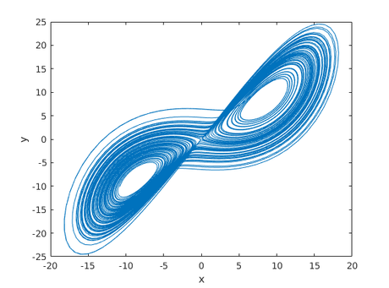
Lorenz Eqns again: Low dimensional Strange Attractor
Allows ergodic predictions: ‘climate’

Slide 29
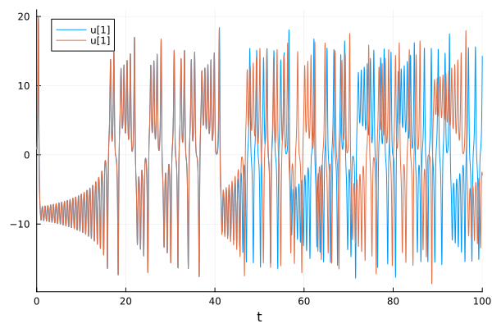

Slide 30
Be warned about over hyped claims of PINNS for predicting chaotic systems
System may not be chaotic for the parameters chosen
System may not have been run for long enough (i.e. before the Lyapunov time)
We may be seeing a shadowing phenomenon (not a bad thing but any decent solver can do that )

Slide 31


Basic Idea of Data Assimilation
True state: of a system is
Predicted state:
Data: observations y of some function
H(x_{t}) of the true state
Both the prediction and the data have errors

Slide 32
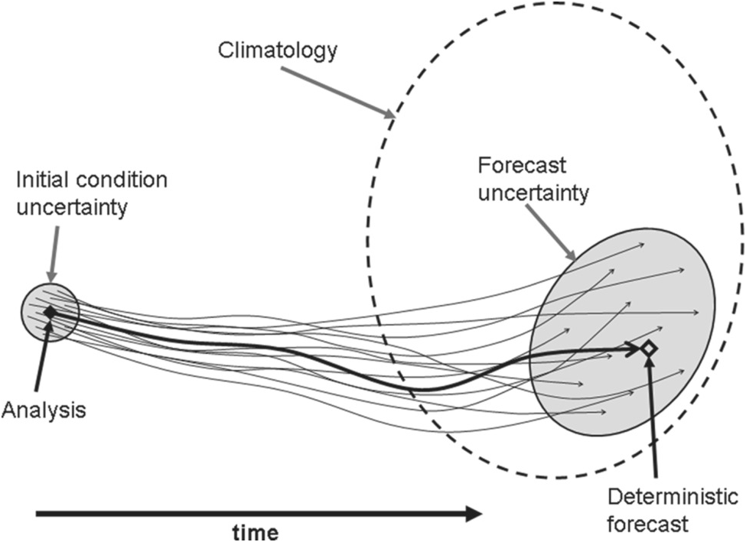

Slide 33
Data assimilation optimally estimates the system state which is consistent with both the prediction and the data and estimates the resulting error

Slide 34
Data error ellipse: size E_{data}
Data: D
Analysis: A
Use A to
produce a forecast
Nudging
Prior estimate: P
Prediction error ellipse: size E_{pred}

Slide 35
Data error: Gaussian, Covariance R
Background prediction error: Gaussian, Covariance B
Maximum likelihood of data y given truth x is
BLUE: Find which maximises M or minimizes J

Slide 36
Data sets you can play with created using this approach
Reanalysis:
UKCP18
ERA5
Created using the previous methods

Slide 37
Historical Data: HadUK-Grid
UK Spatial resolution: 1km x 1km
Time span: 1862 to present
Temporal resolution: daily, monthly, seasonal and annual timescales, as well as long term averages for a set of climatological reference periods
Variables: air temperature (maximum, minimum and mean), precipitation, sunshine, mean sea level pressure, wind speed, relative humidity, vapour pressure, days of snow lying, and days of ground frost

Slide 38
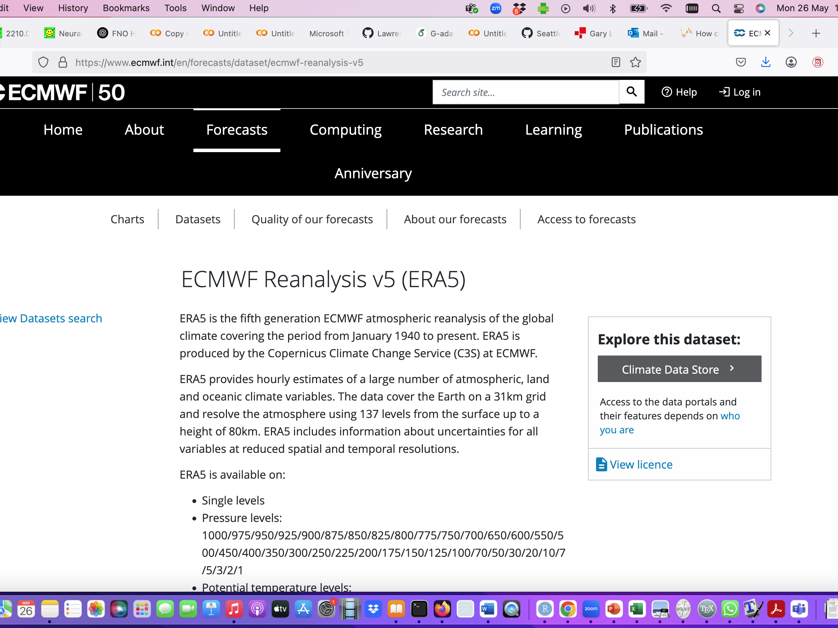

Slide 40
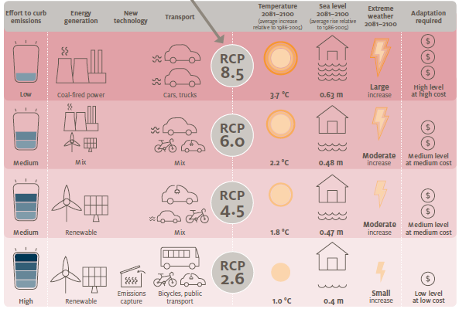
Probable Scenarios

Slide 41
Big claim papers which make use of these data sets
GraphCast & Aardvark
Methodology: Neural operator based method
Results
Concerns

Slide 42


Slide 43


Slide 44


Slide 45
“Our results demonstrate that PINNs do not exhibit any sensitivity to perturbations in the initial condition. Instead, the PINN optimization consistently converges to physically correct solutions that violate the initial condition only marginally, but diverge significantly from the desired solution due to the chaotic nature of the system. In fact, the PINN predictions primarily exhibit low-frequency components with a smaller magnitude of higher-order derivatives, which favors lower physics loss values compared to the desired solution. We thus hypothesize that the PINNs “cheat” by shifting the initial conditions to values that correspond to physically correct solutions that are easier to learn.”

Slide 46
Parametrisations: Caramel
Cloud fraction prediction

Slide 47
Downscaling

Slide 48
Generating High-Resolution Data from Low-Resolution Data

Slide 49
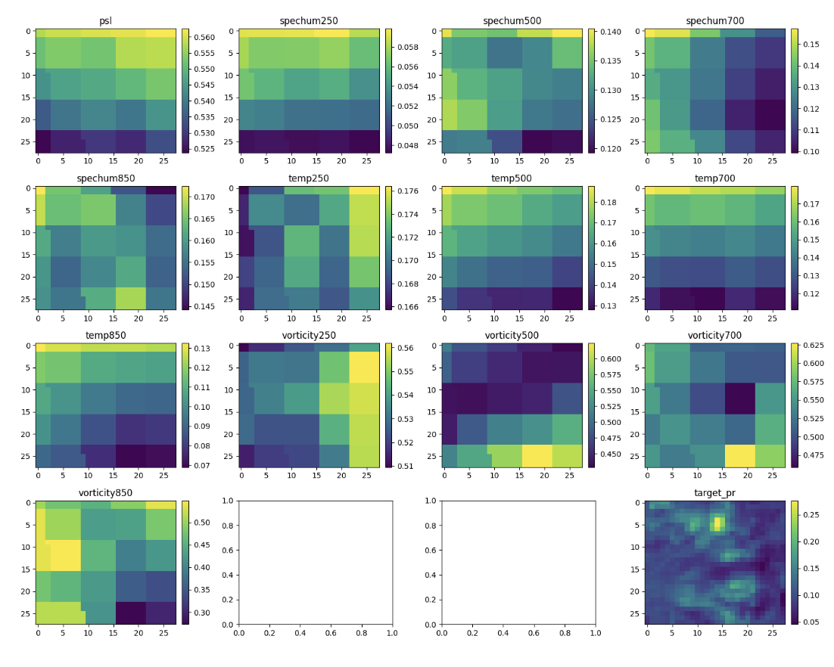
Spatial Distribution of 13 Variables and Target Precipitation

Slide 50
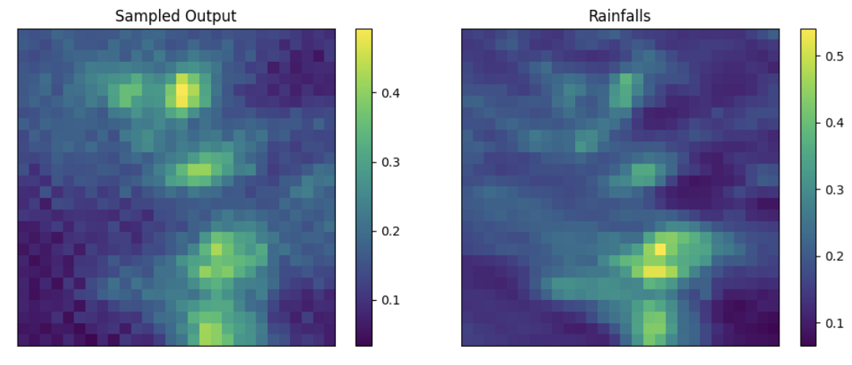
Result

Slide 51
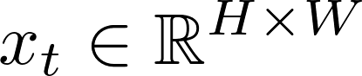
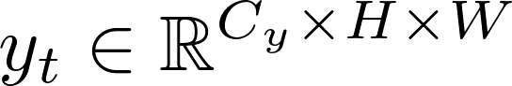
The Problem
Objective: Use temporally-sequenced low-resolution simulations (GCM) to generate temporally-sequenced high-resolution precipitation fields.
Motivation: High-resolution climate simulations are computationally expensive,
Diffusion model design for static data(2D)
Data:
: high-resolution precipitation field 16.6km
: GCM outputs 60km, and corase precipitation 8.8*7 km

Slide 52





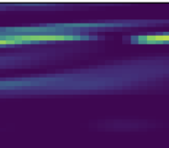

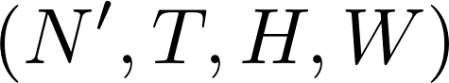
Adding Temporal Information
Forward
Reverse

Slide 53
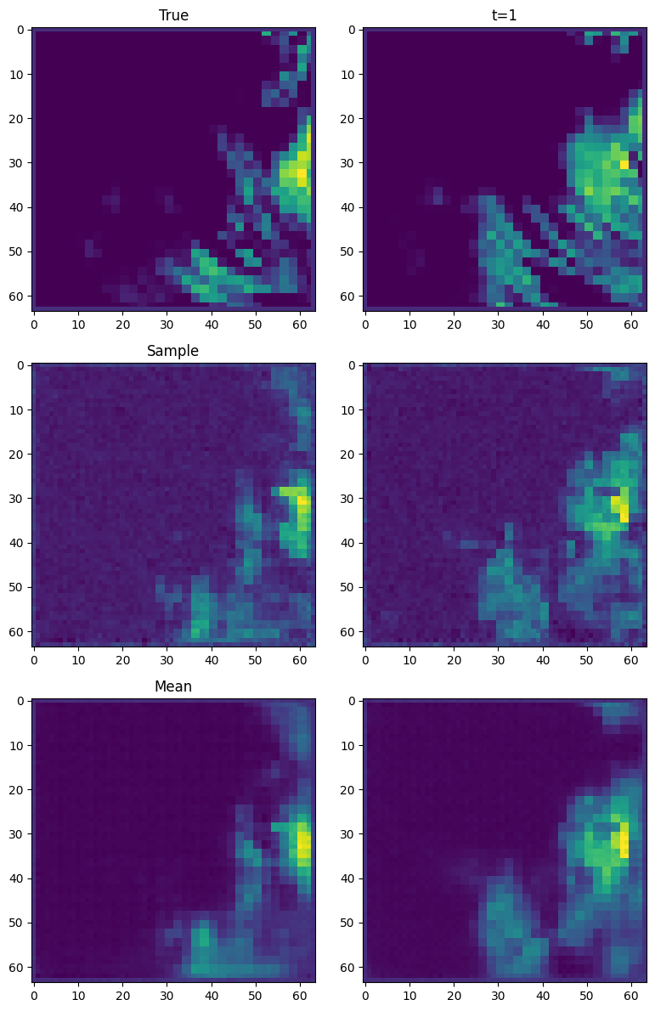
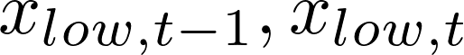
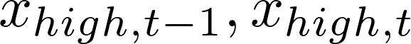
Temporal Upscaling from Coarse-Resolution Precipitation
Input:
Output:
Model Type: Autoregressive baseline

Slide 54
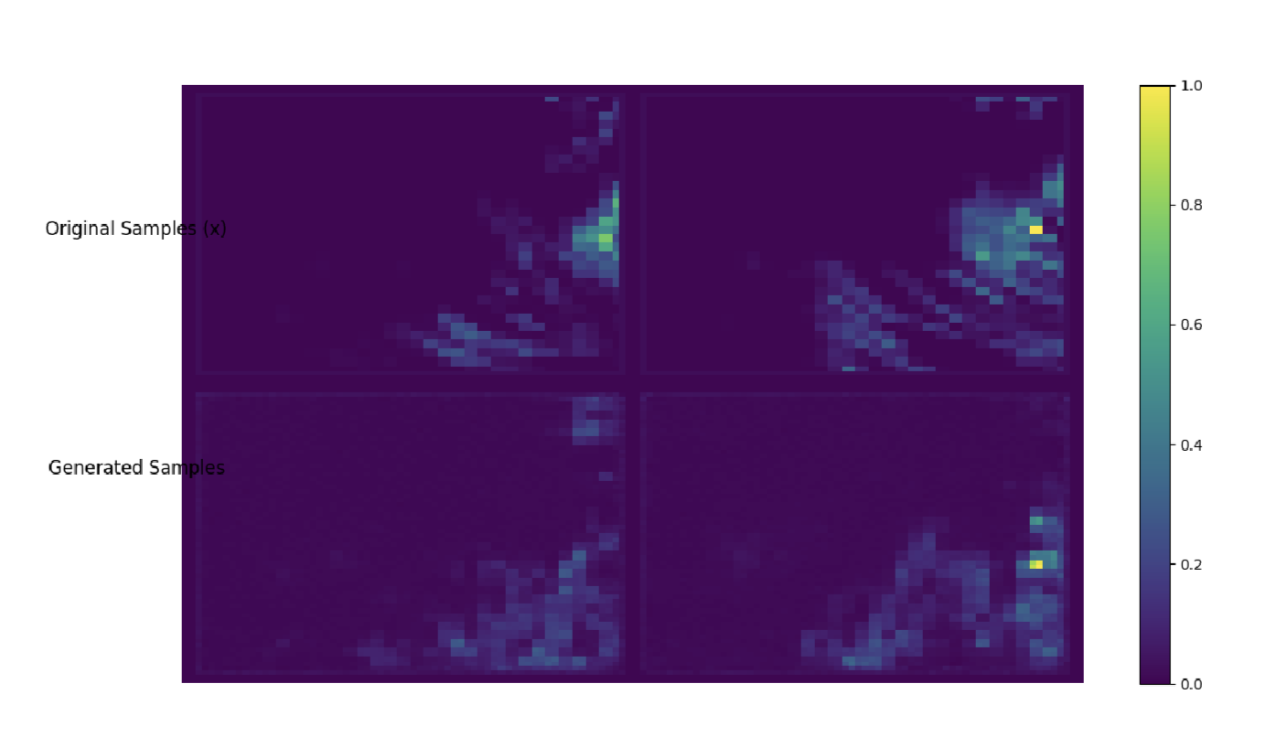
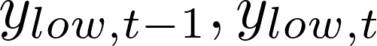
Physics-informed approach (meteorological variables)
Model Type: Physics-informed approach

Slide 55
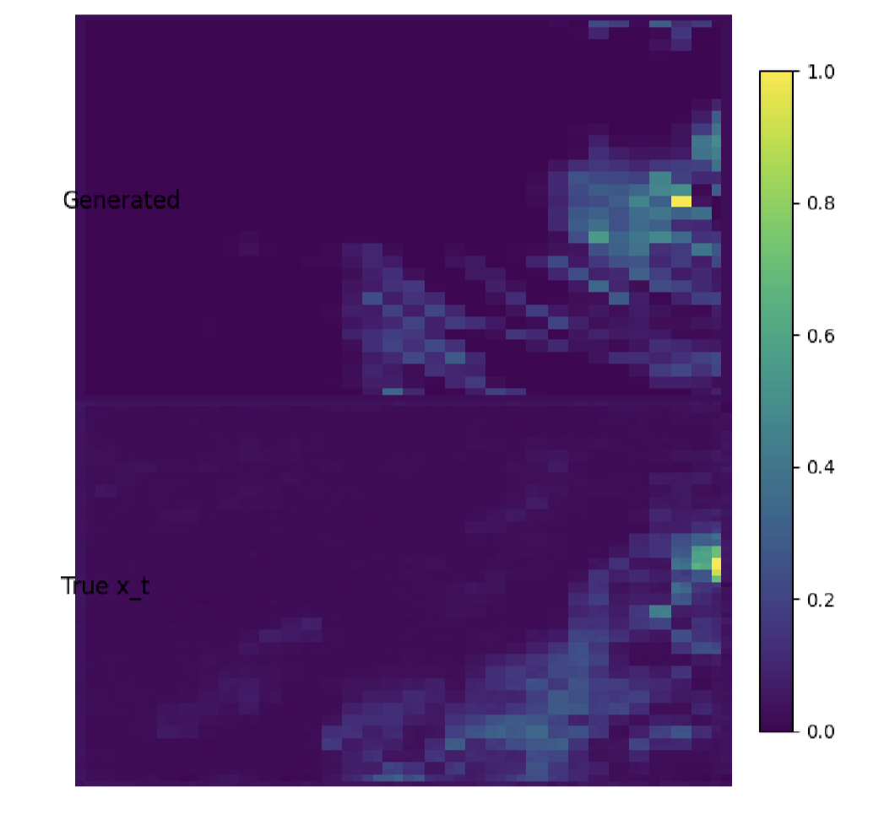
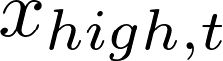
Historical precipitation plus meteorological variables
Input:
Output:
Model Type: Extended autoregressive approach

Slide 56
Next Steps

Slide 57
Future Plans
Metric-based evaluation
Joint modeling
Quantitative comparison using Loss, RMSE, CSI, Frenquency Density, Precentile
Visualization of generated pcitures
Summarize strengths and weaknesses of different modeling approaches
Saptial model+Temporal model
Compare prediction quality and computational cost.

Slide 58


Thank you for listening！
lc2762@bath.ac.uk

Slide 59
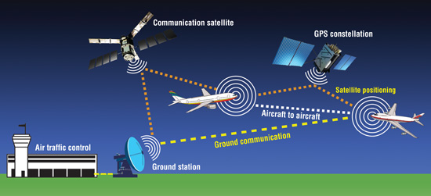
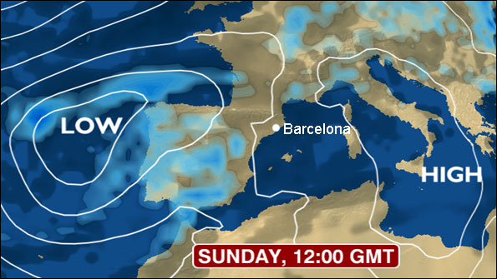
Conclusions
Data assimilation is an optimal way of merging models with data and finding the error
Many applications!

